Slide 1
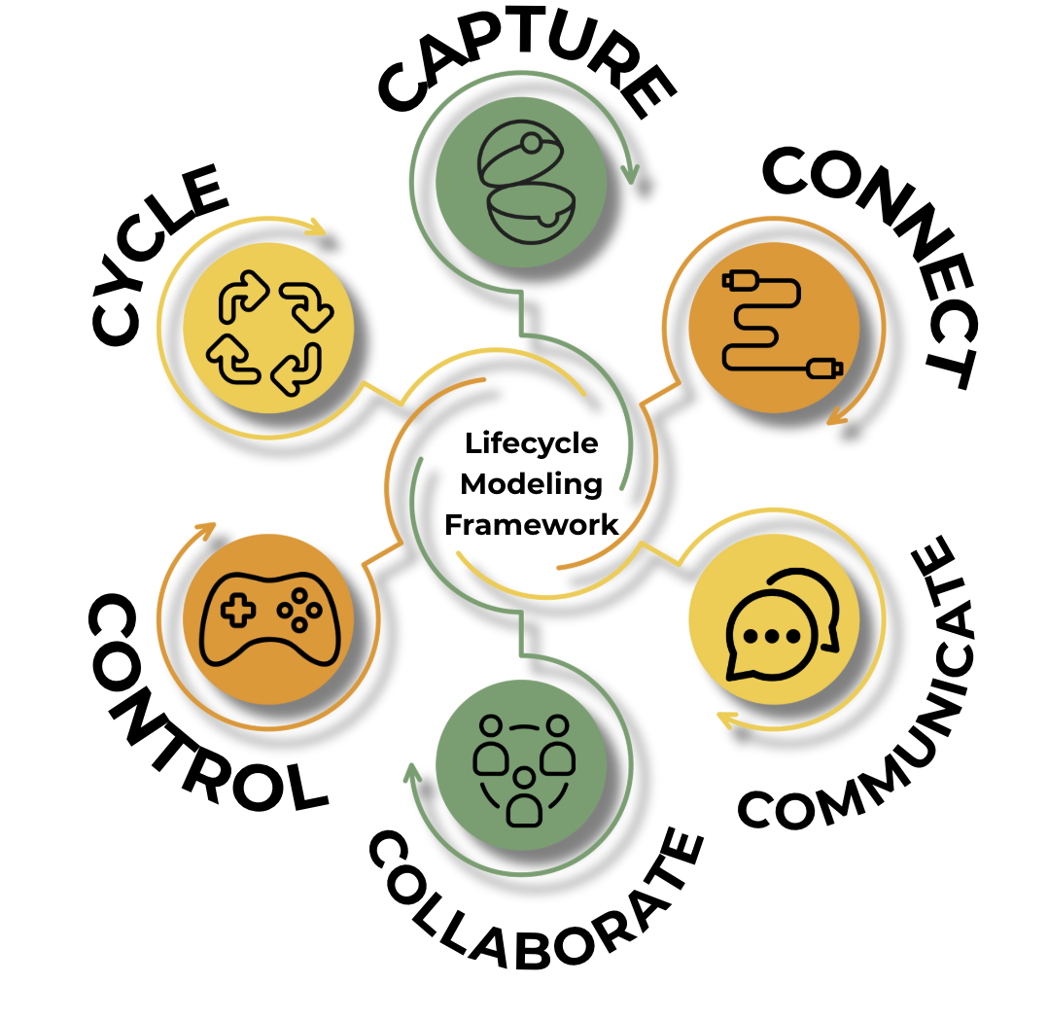
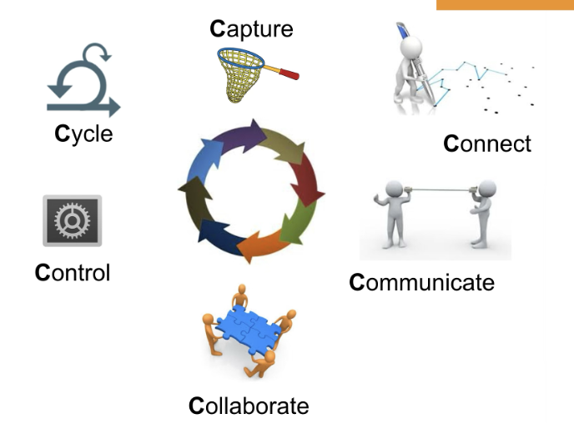
Notes:
6 Cs of LMF

Slide 2
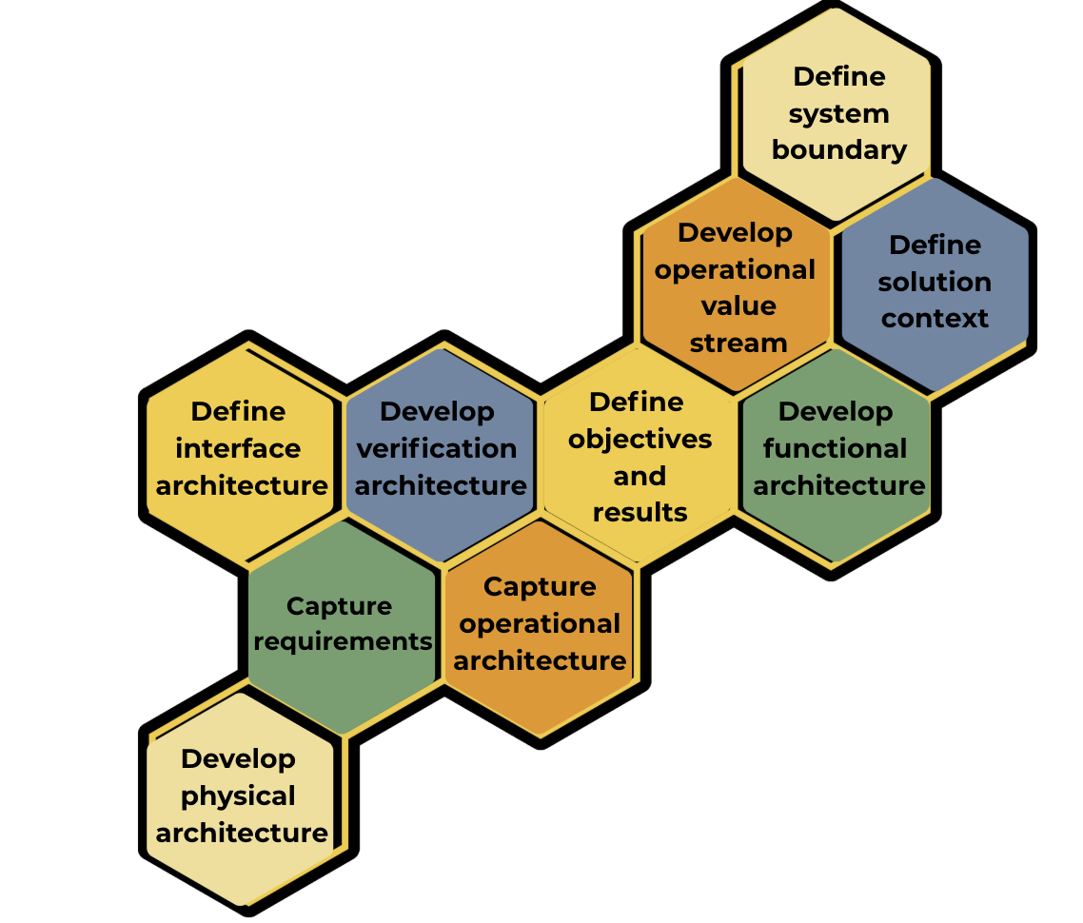
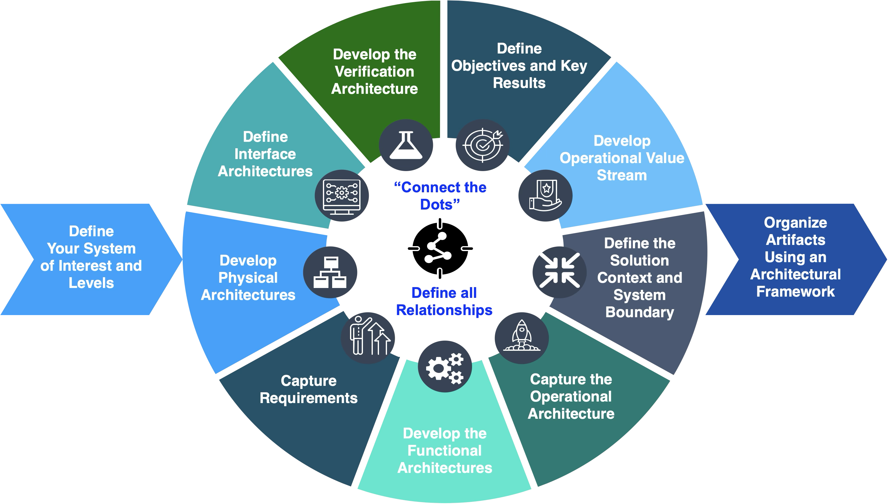
Notes:
Systems modeling tasks

Slide 3
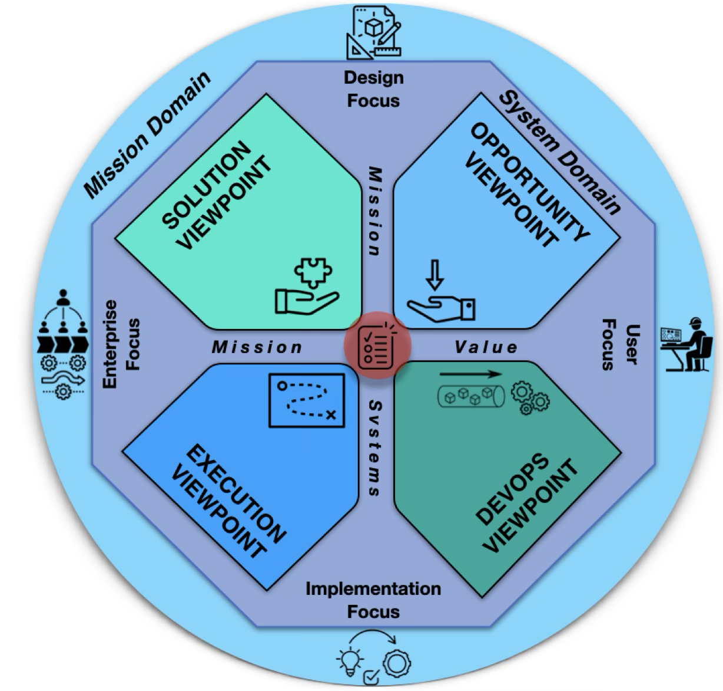

Notes:
LMF viewpoints

Slide 4
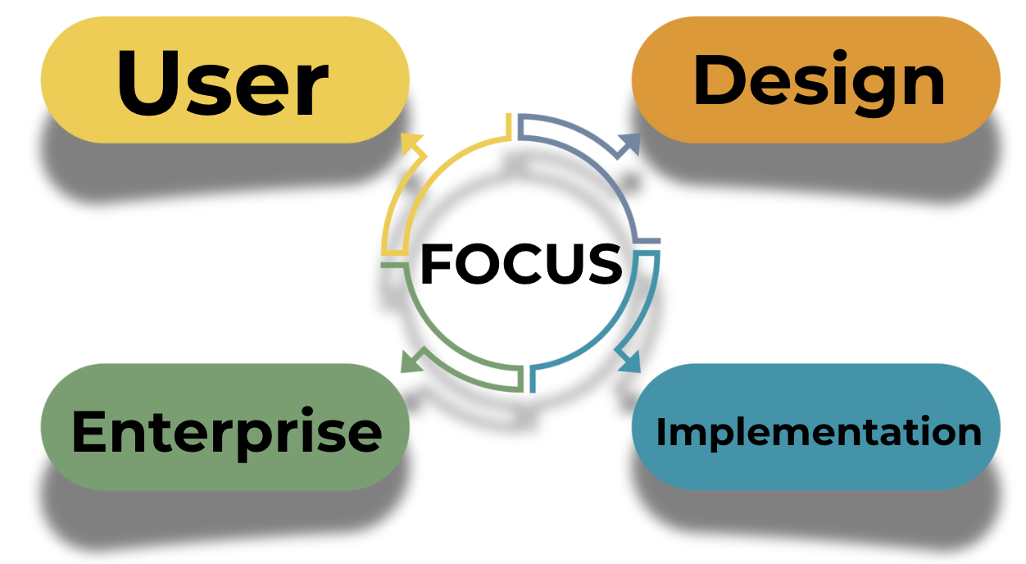
Notes:
4 focus areas of LMF

Slide 5
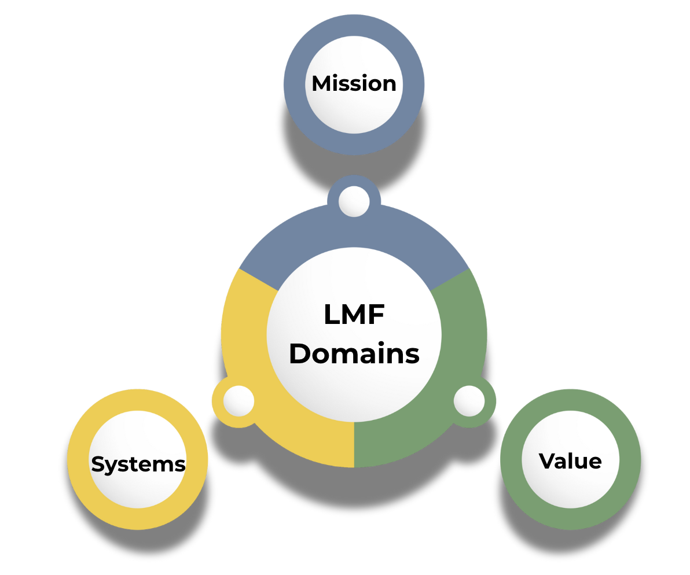

Slide 6
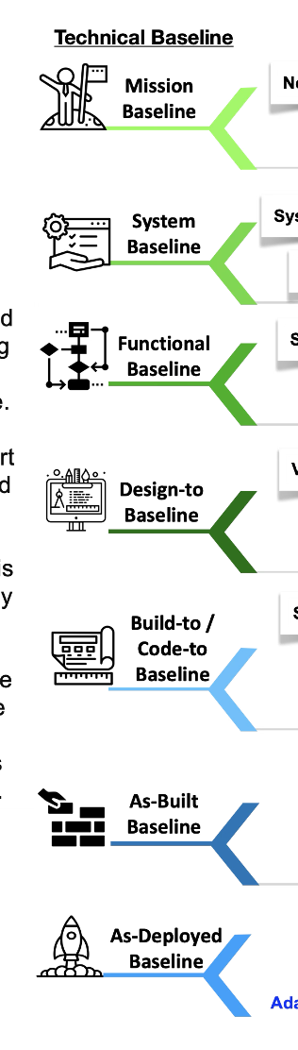
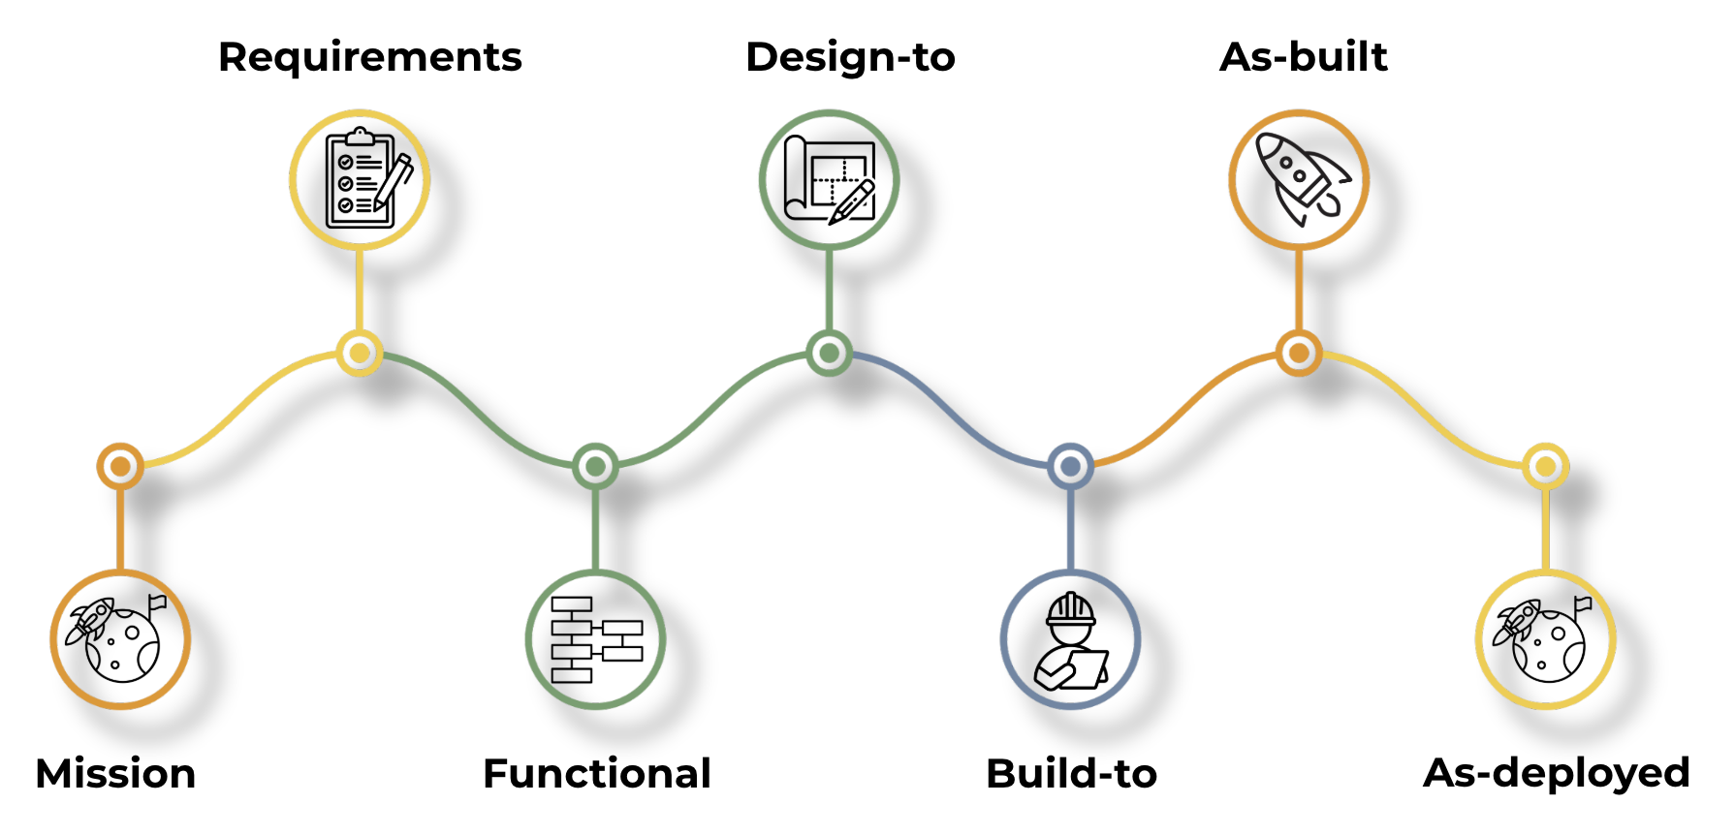
Notes:
baselines

Slide 7



Notes:
Forward and reverse modeling

Slide 8

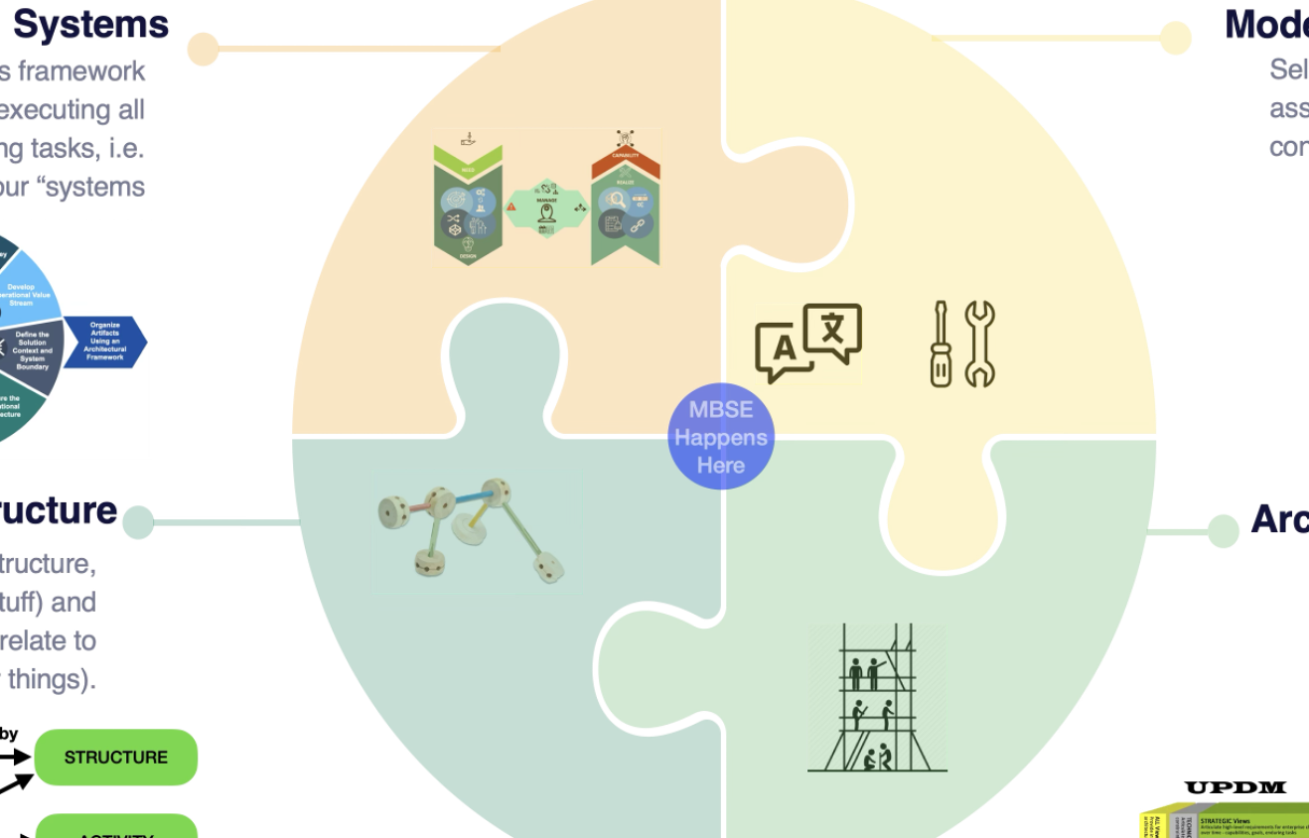
Notes:
Start up necessities

Slide 9
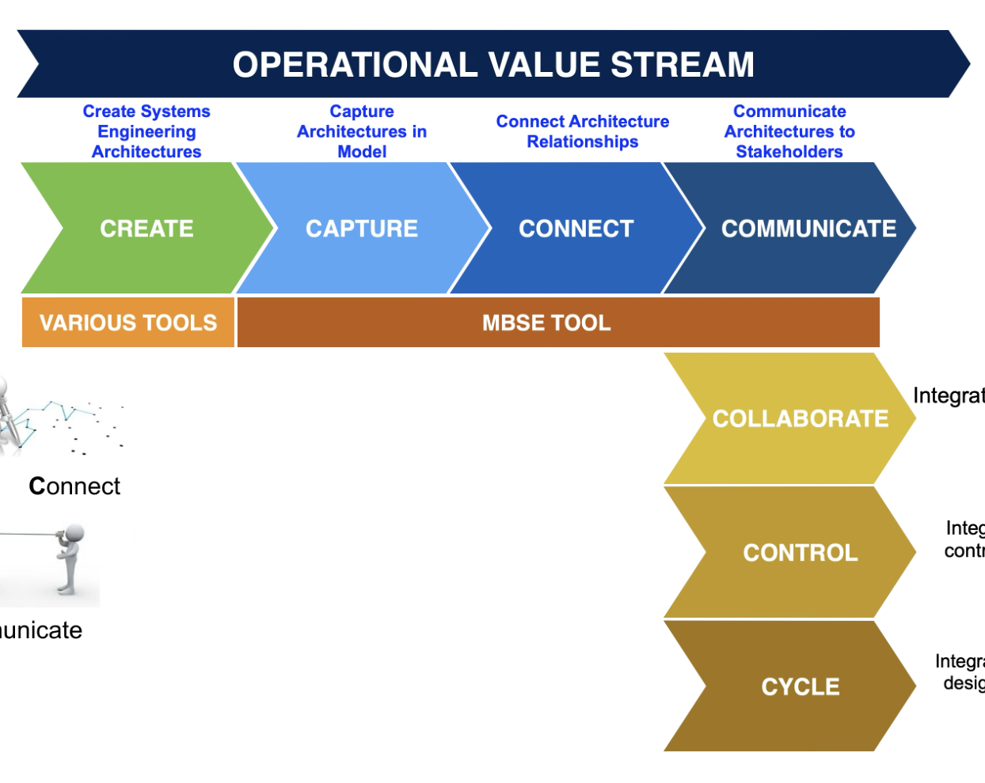
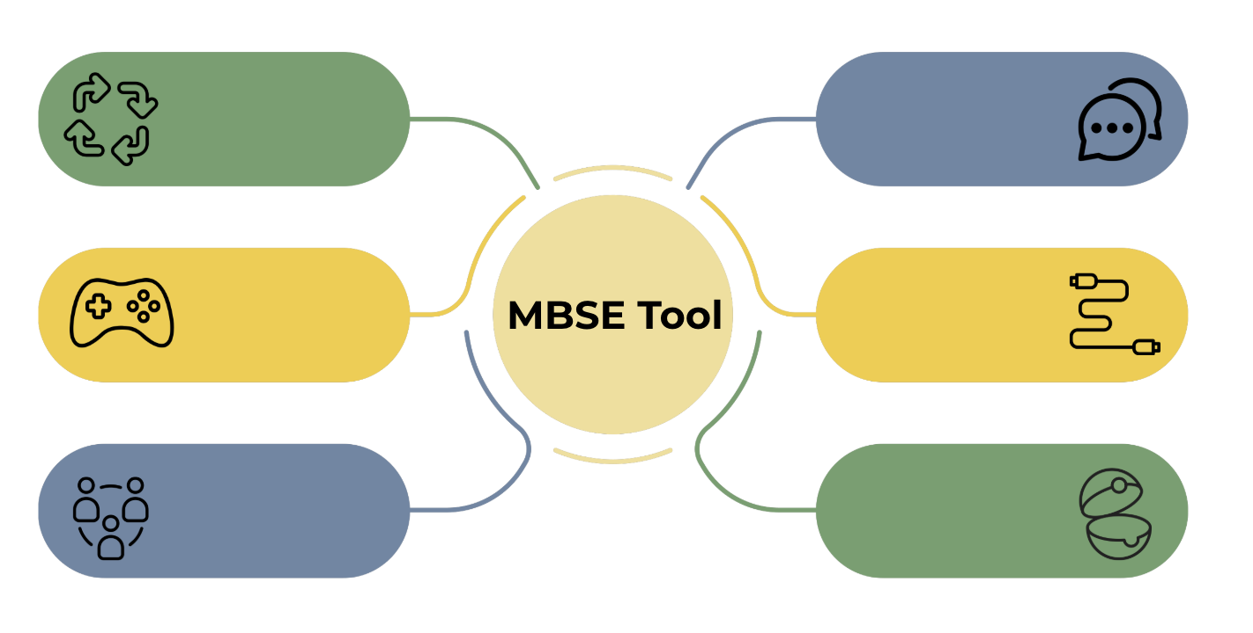
Notes:
MBSE tool

Slide 10
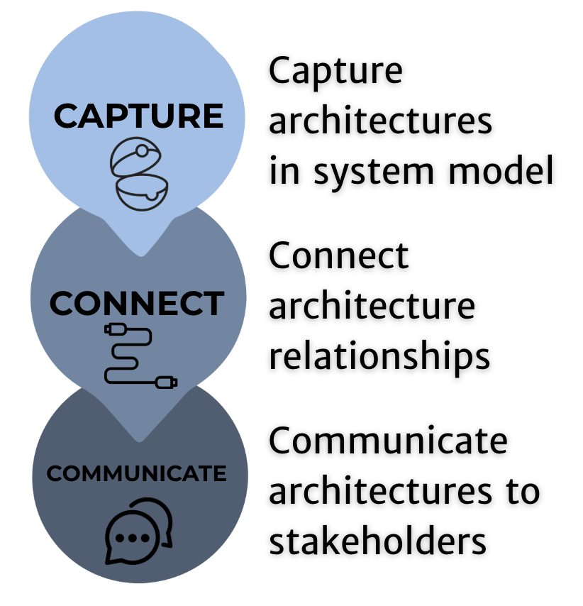

Slide 11
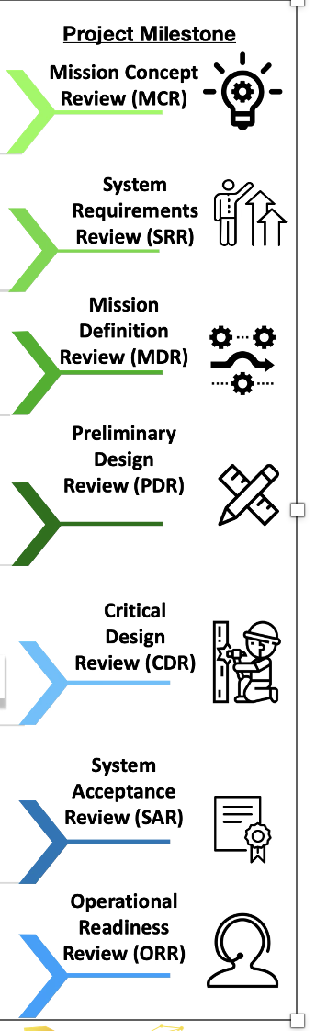
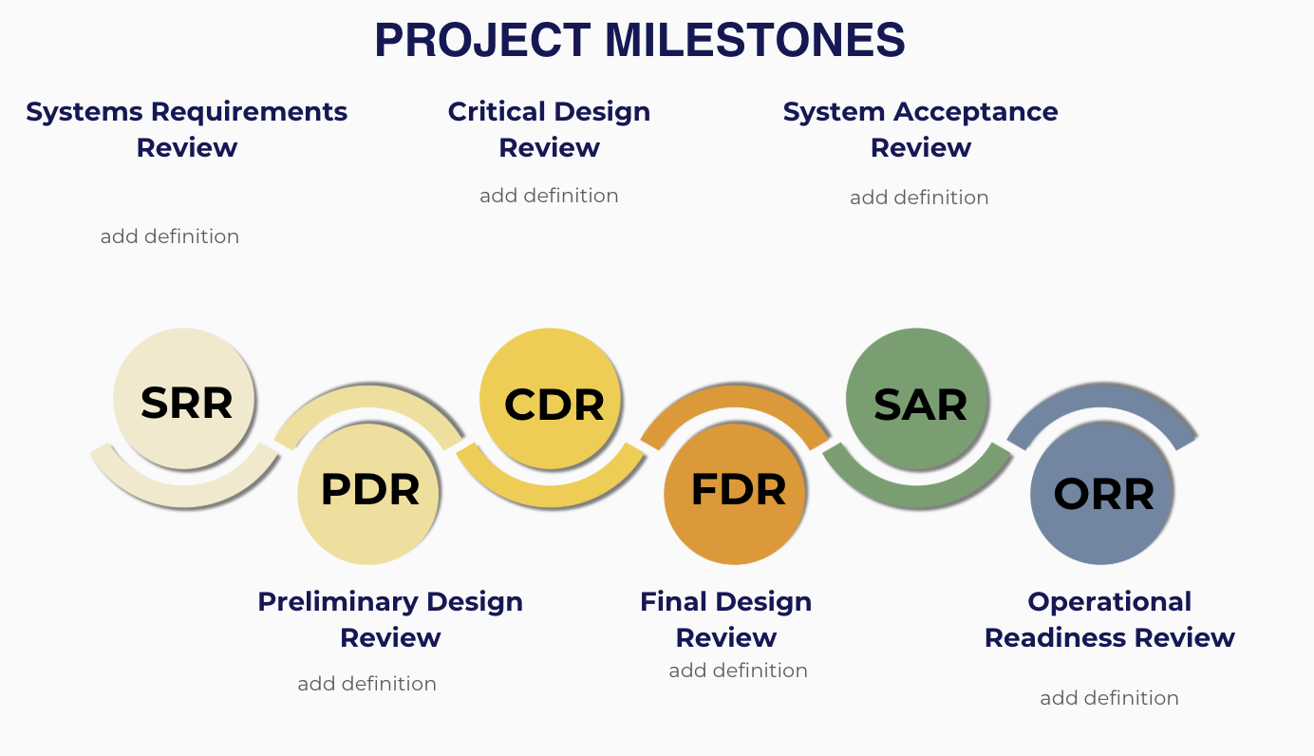

Slide 12
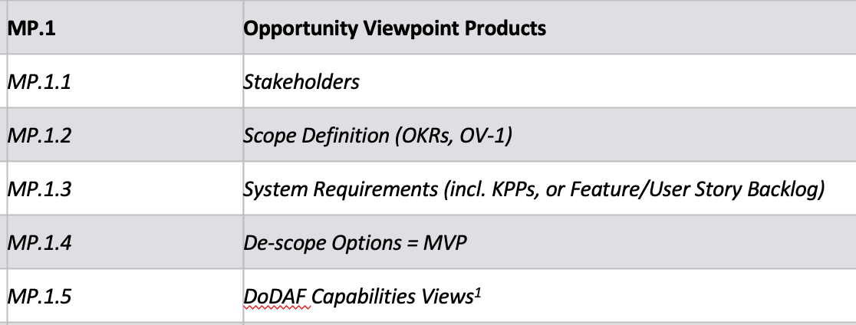
Notes:
Opportunity View Products

Slide 13
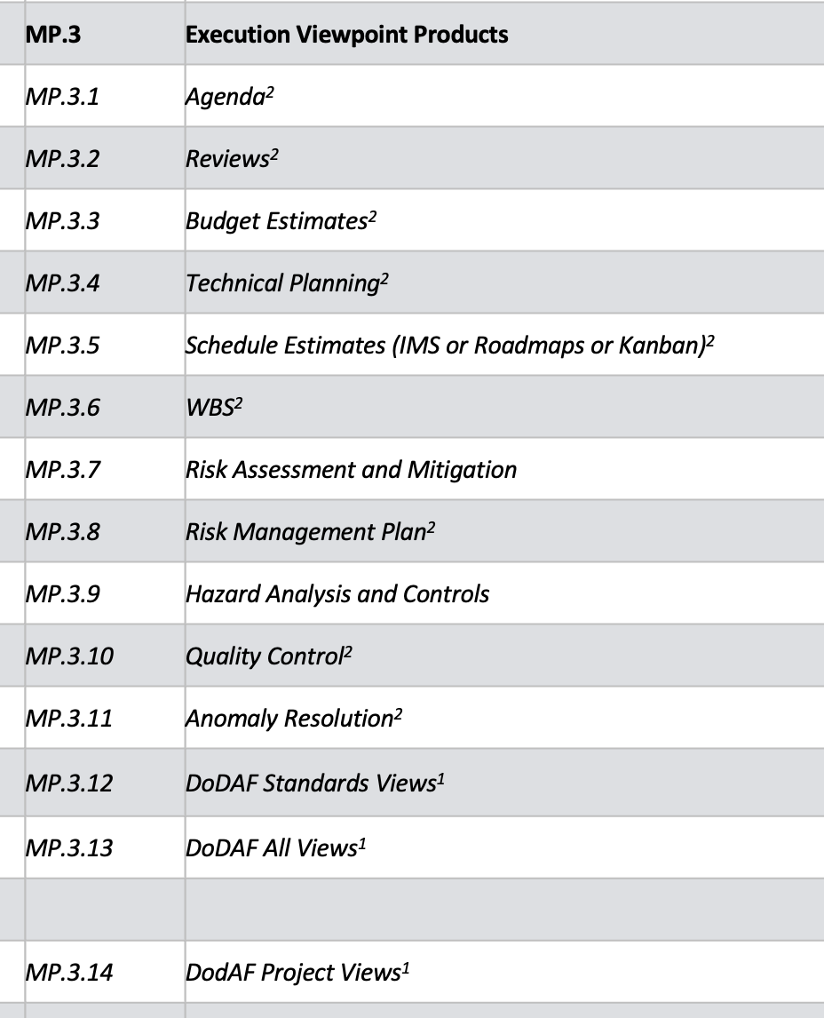
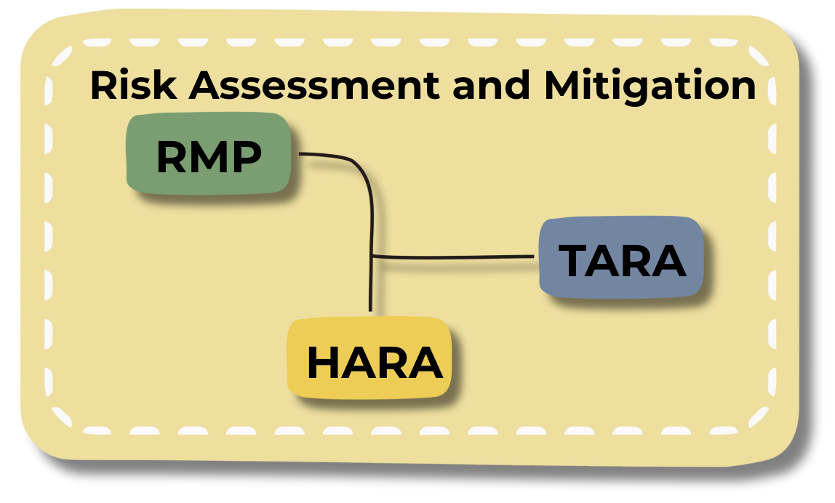
Notes:
Risk deliverables

Slide 14
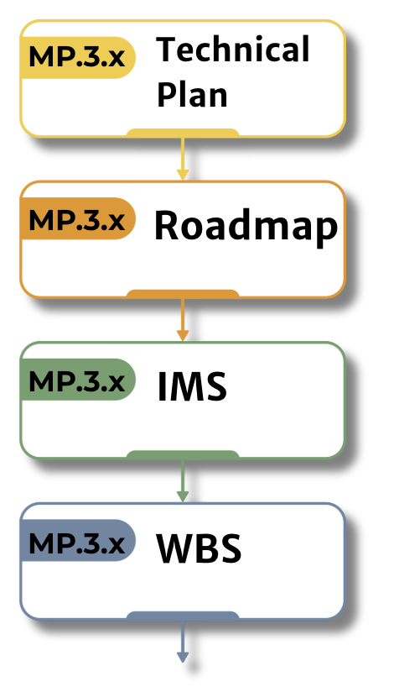
Notes:
scheduling

Slide 15
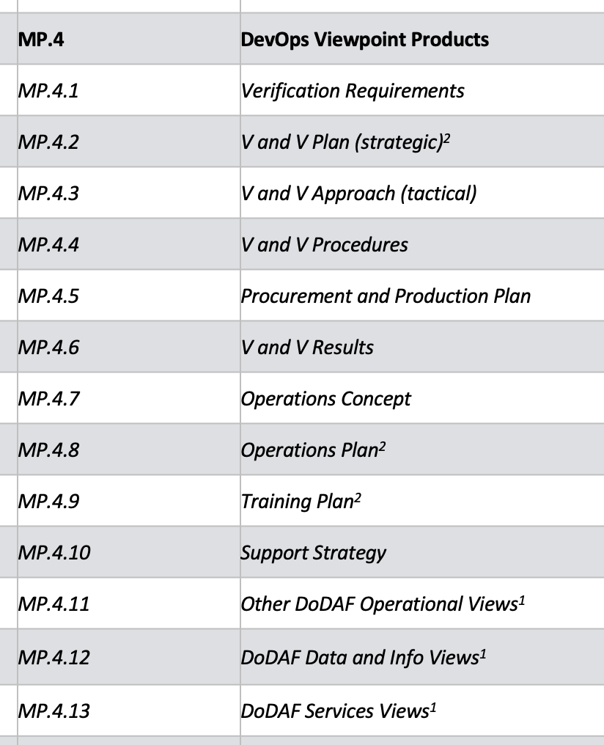
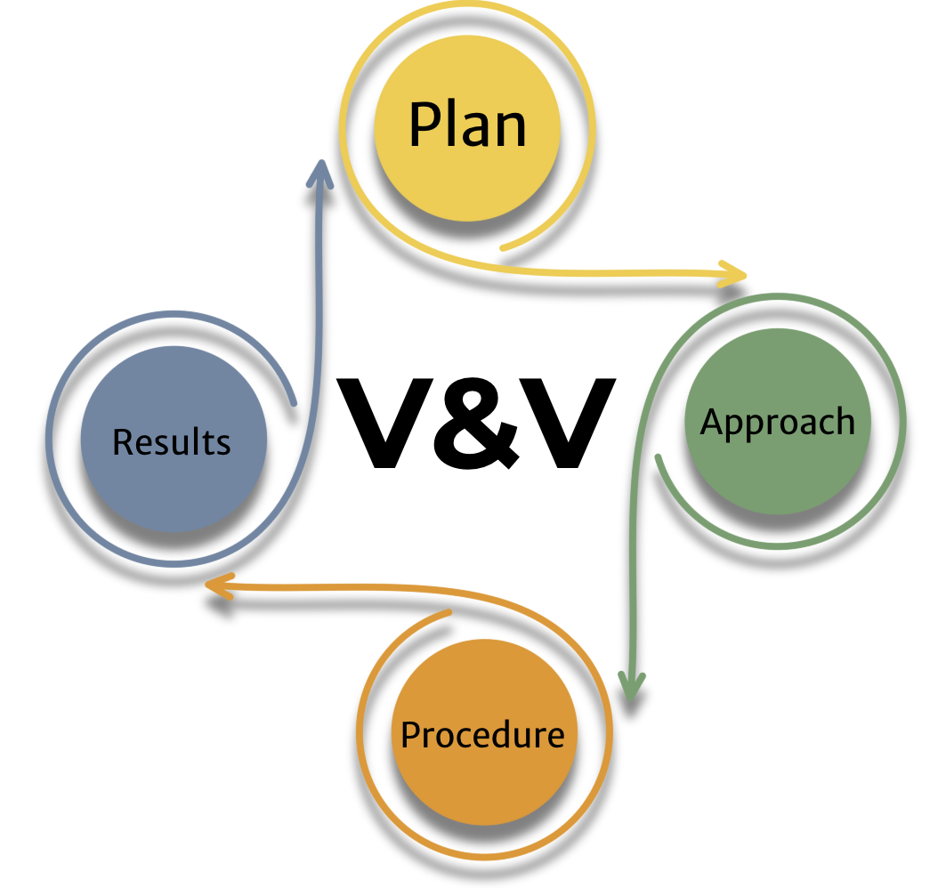
Notes:
V&V

Slide 16
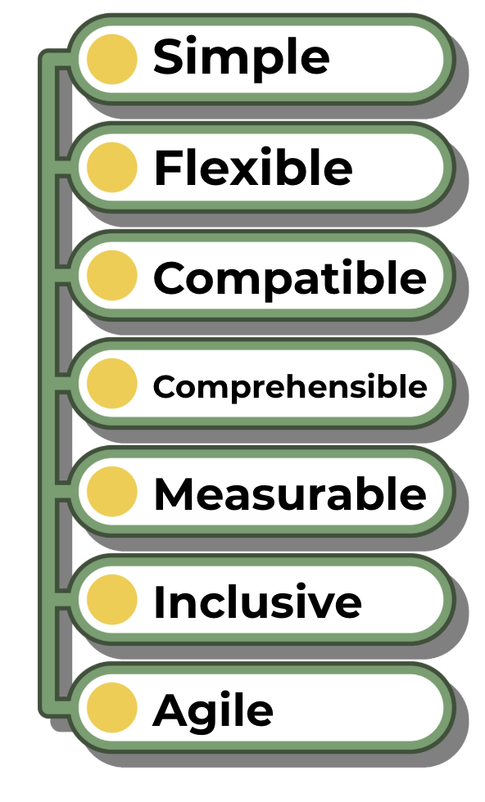
Notes:
LML goals

Slide 17
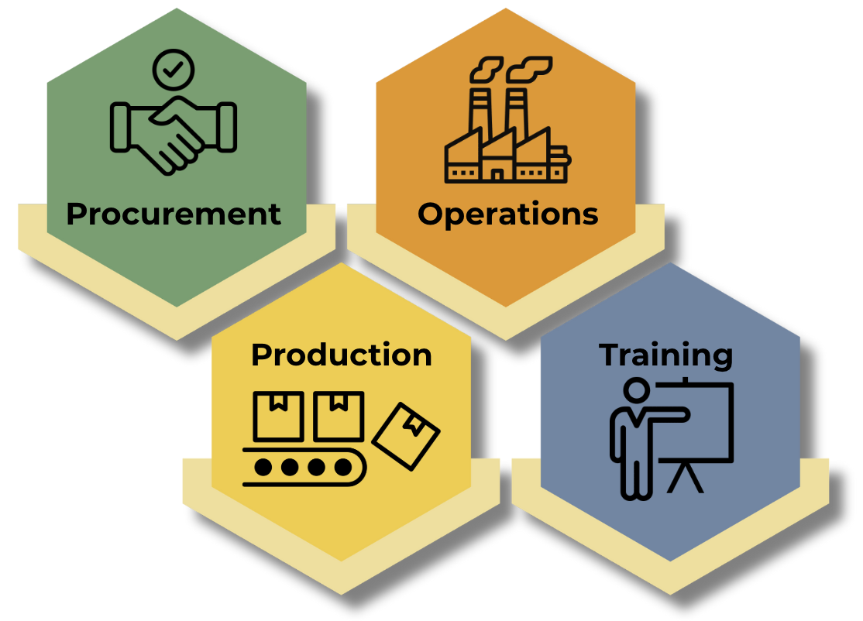
Notes:
plans

Slide 18
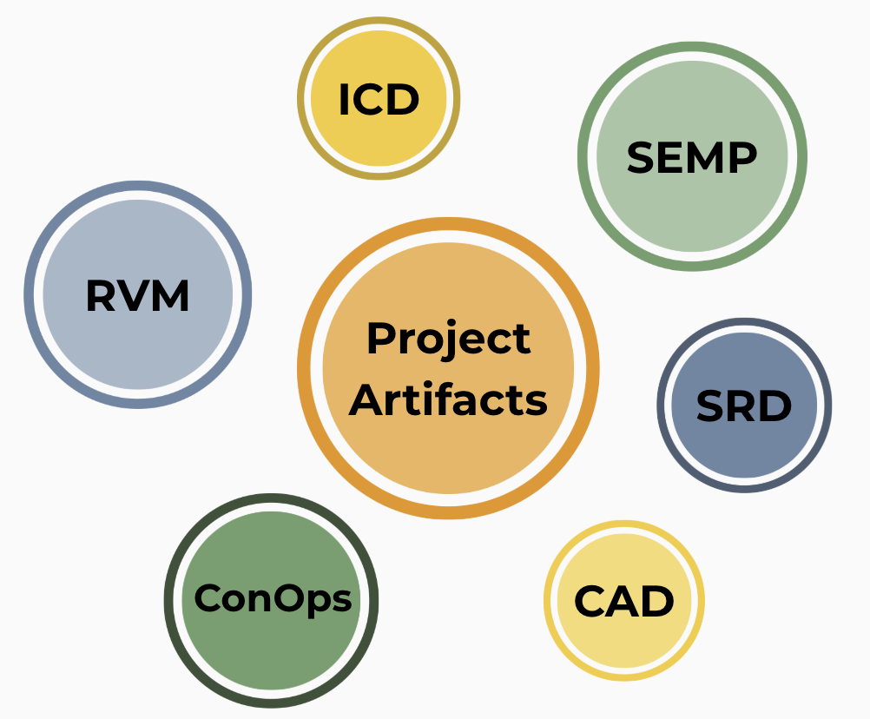
Notes:
Example of artifacts

Slide 19
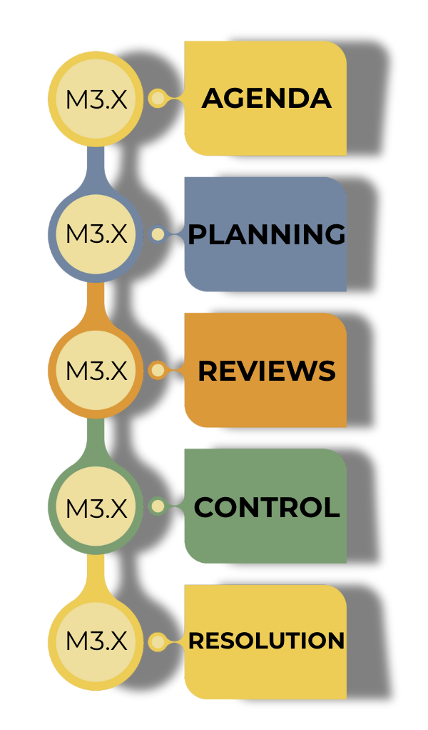
Notes:
QUALITY

Slide 20
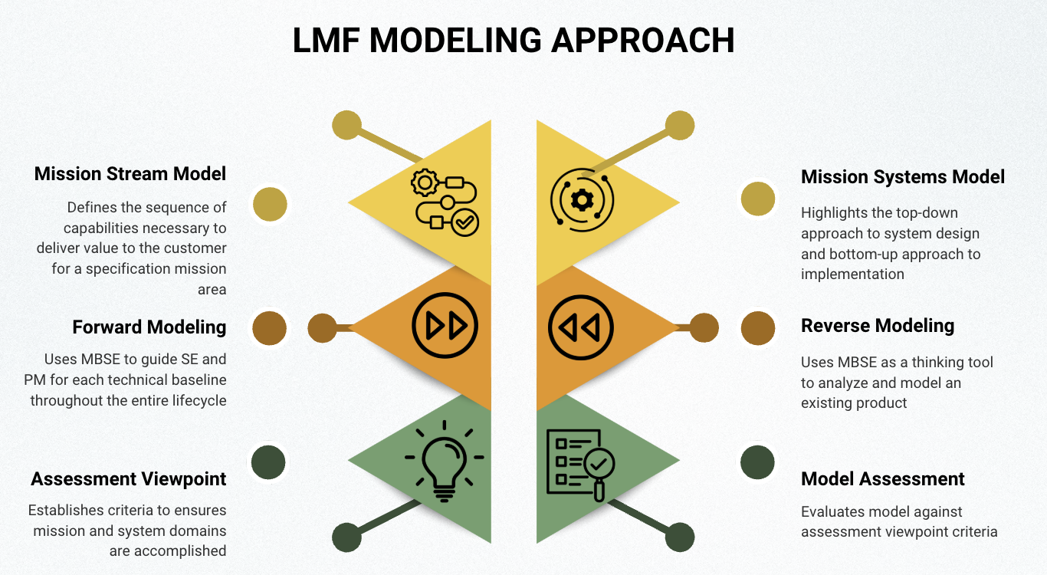
Notes:
LMF Modeling Approach

Slide 21
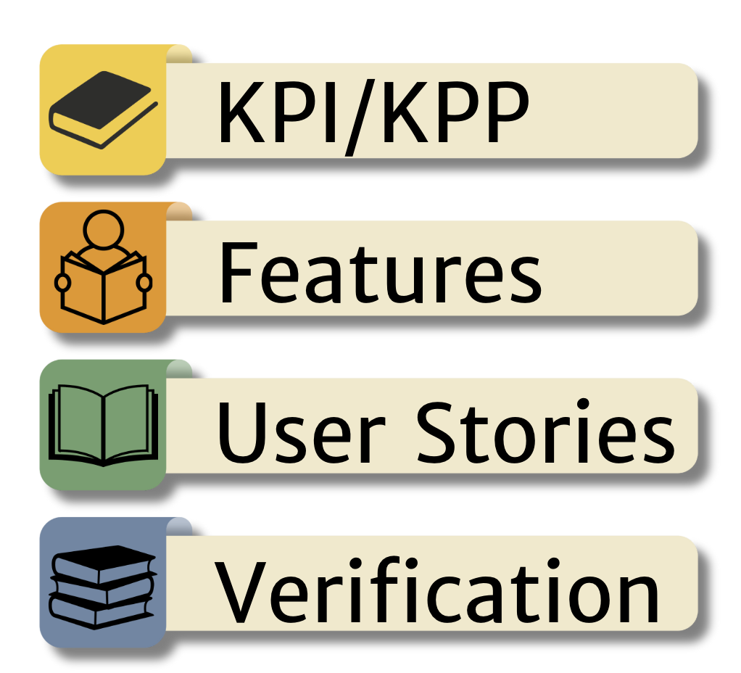
Notes:
Types of requirements

Slide 22
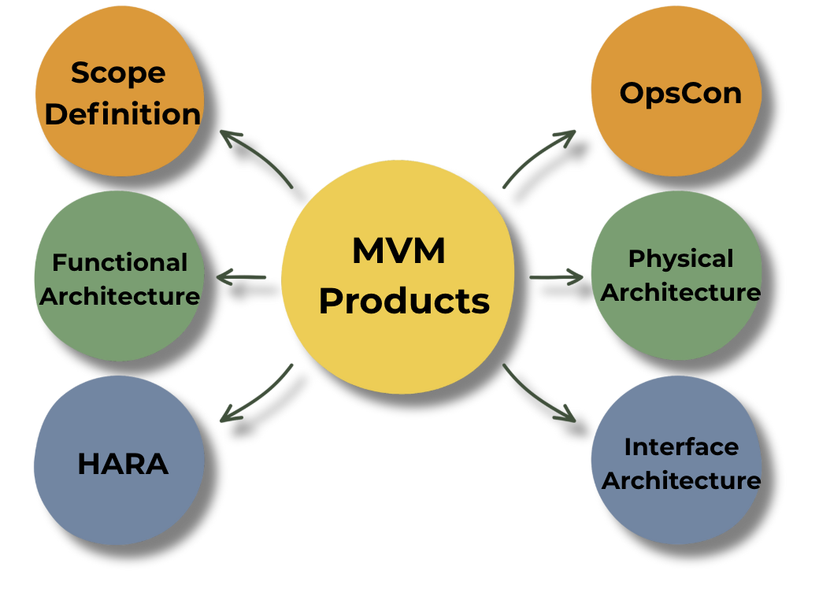
Minimum Viable Model Products
✔︎ | Mission Value Stream Model
✔︎ | Mission Systems Model
✔︎ | MP.1.2 | Scope Definition (OKRs, OV-1)
✔︎ | MP.2.2 | Detailed Functional Architectures
✔︎ | MP.2.3 | Detailed Physical Architectures
✔︎ | MP.2.5 | Interface Architecture (incl. TLM/Cmds)
✔︎ | MP.3.9 | Hazard Analysis and Controls
✔︎ | MP.4.7 | Operations Concept
✔︎ | Assessment Viewpoint Products
Notes:
MVM products

Slide 23

Notes:
LMF lifecycle phases

Slide 24
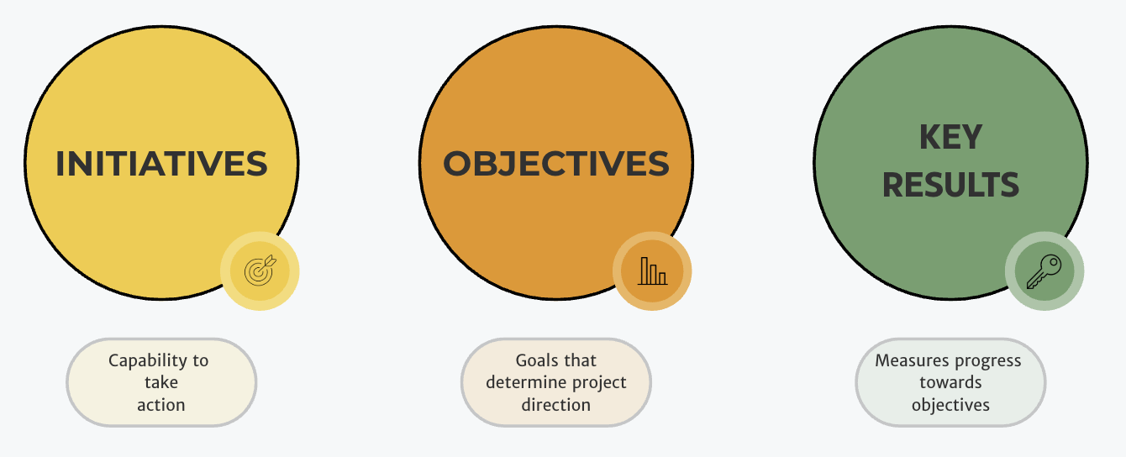
Notes:
Okrs

Slide 25
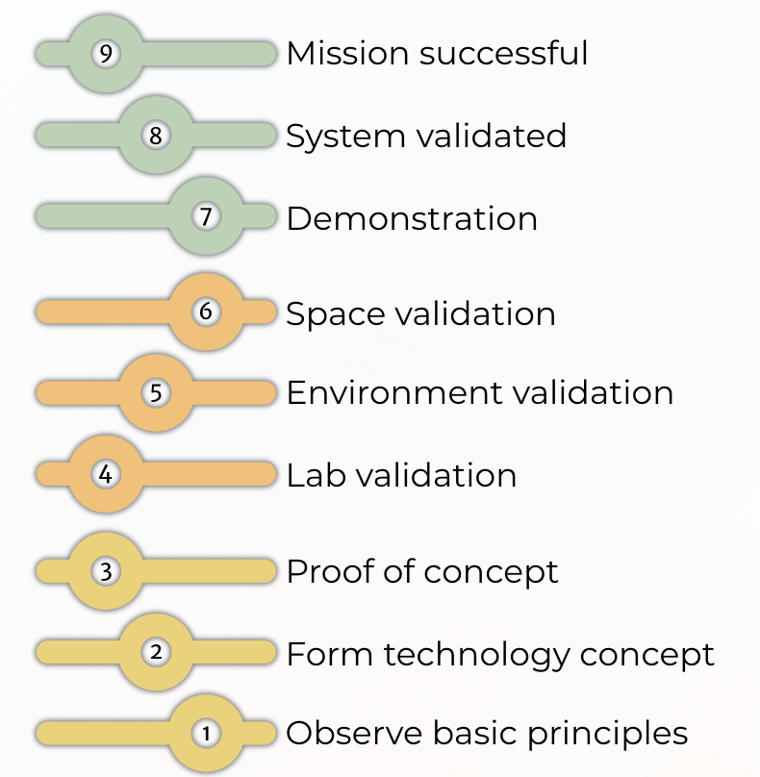
Notes:
Trls

Slide 26
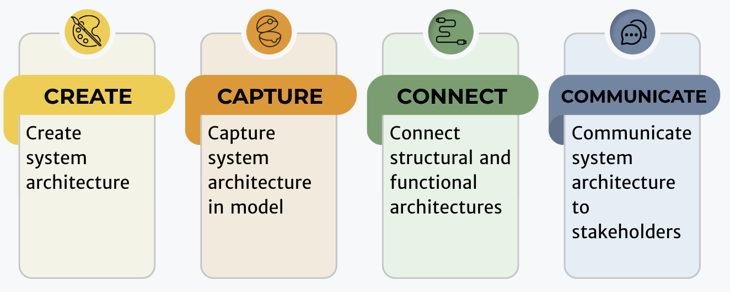
Notes:
Lmf operational value stream

Slide 27
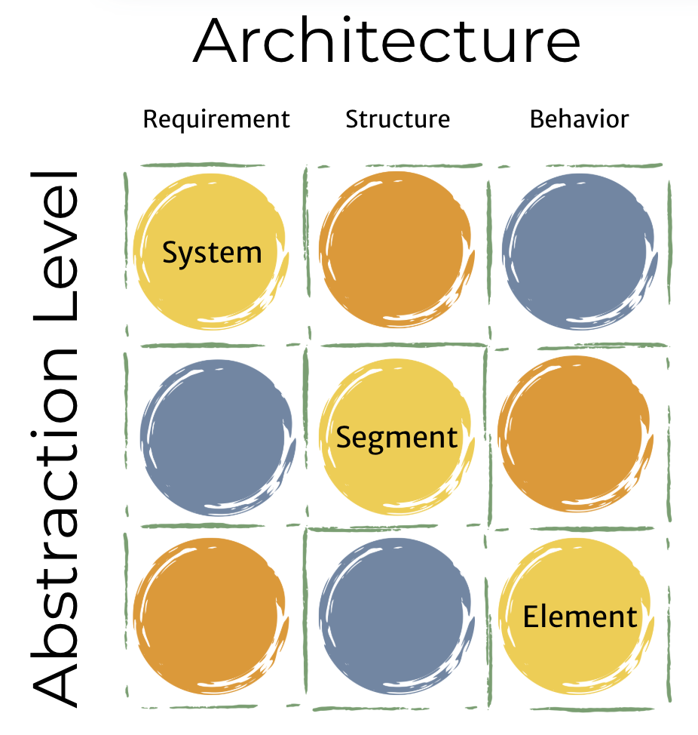

Slide 28

Notes:
LMF requirements

Slide 29
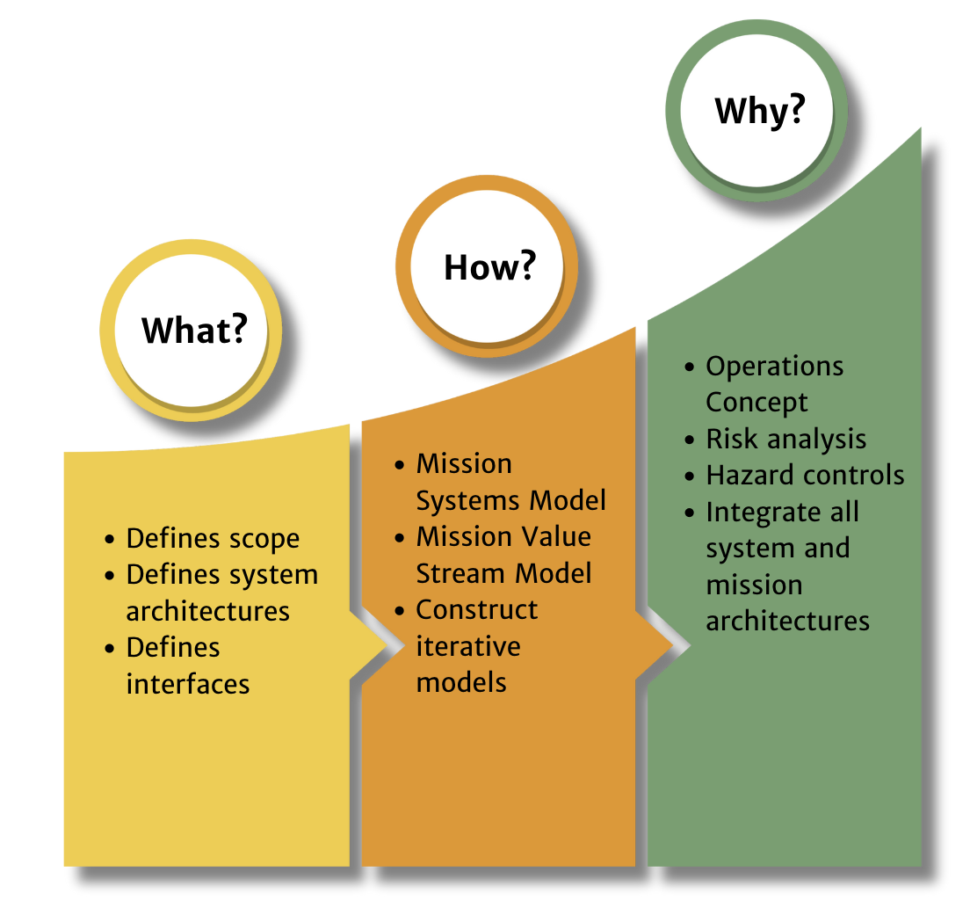
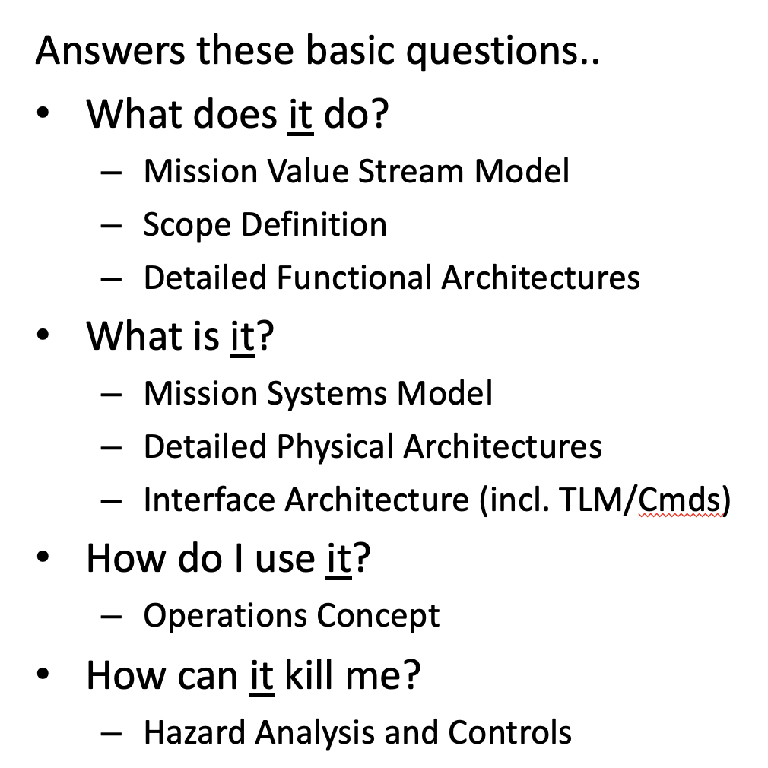
Notes:
MVM

Slide 30
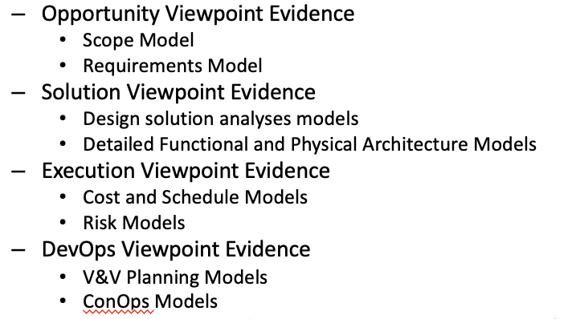
Notes:
LMF viewpoint evidence

Slide 31
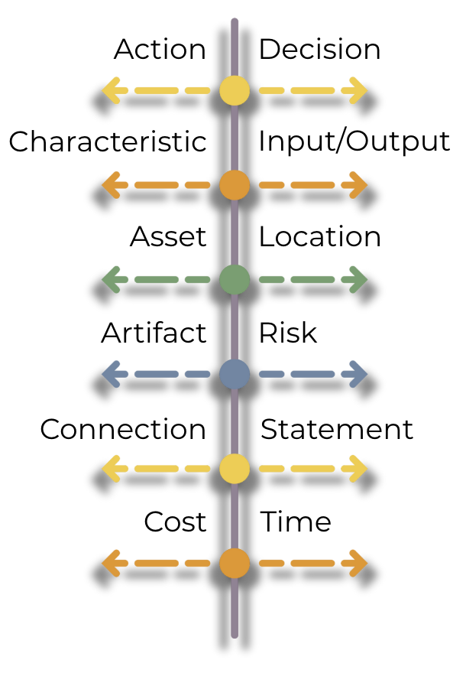
Notes:
LML Core Entities

Slide 32

Notes:
ERA approach

Slide 33


Slide 34
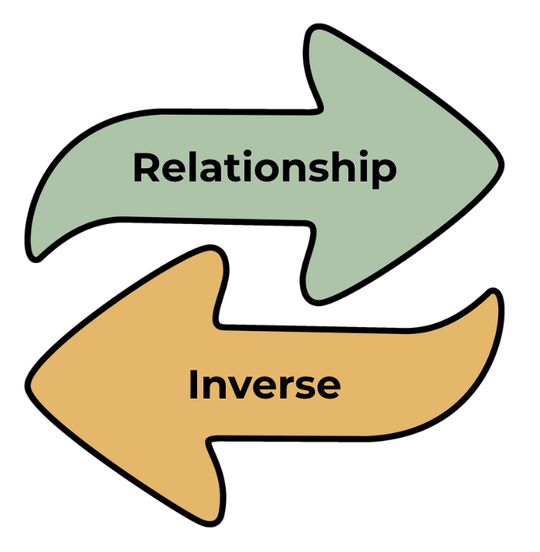

Slide 35
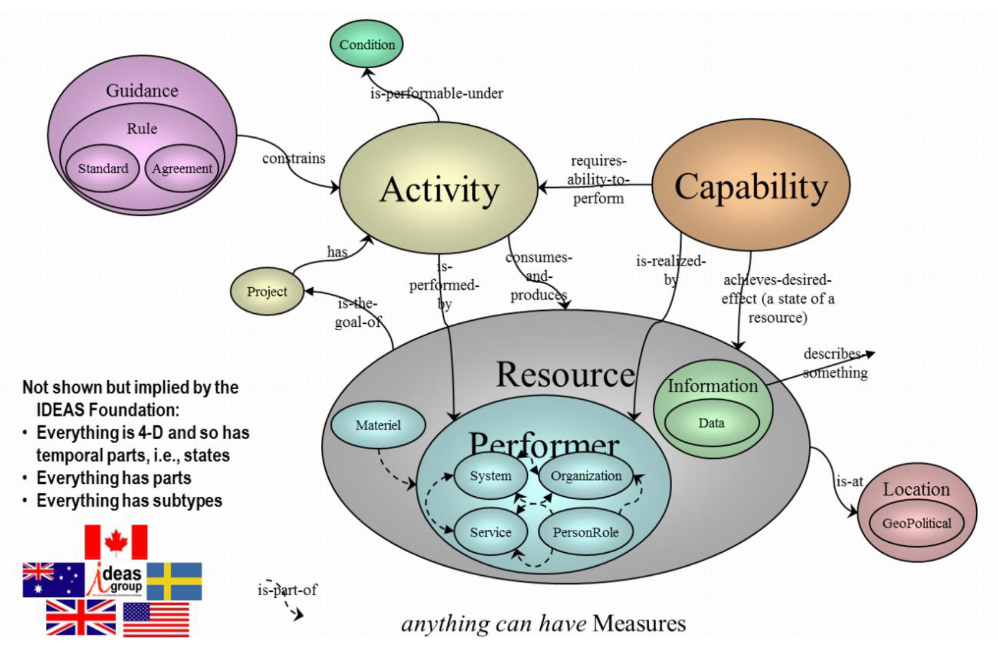

Slide 36
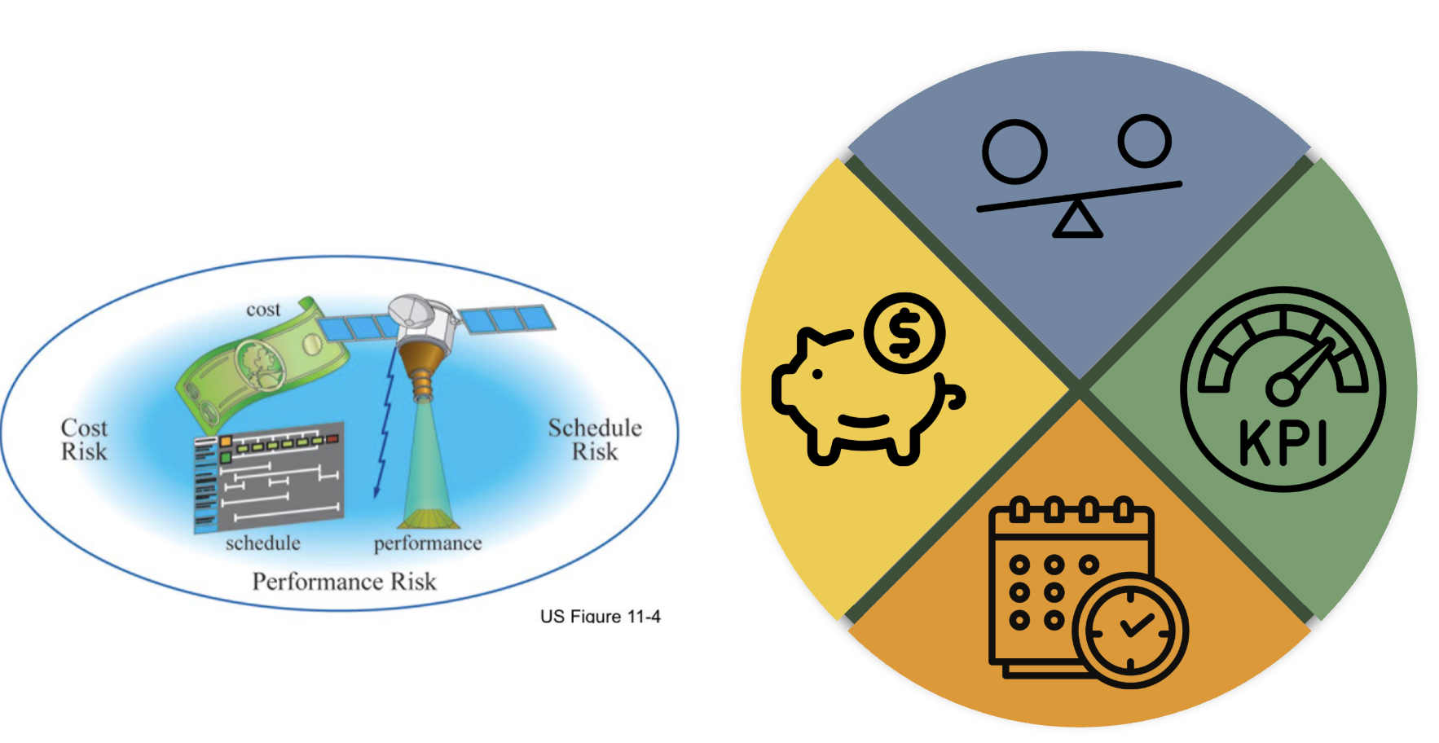

Slide 37
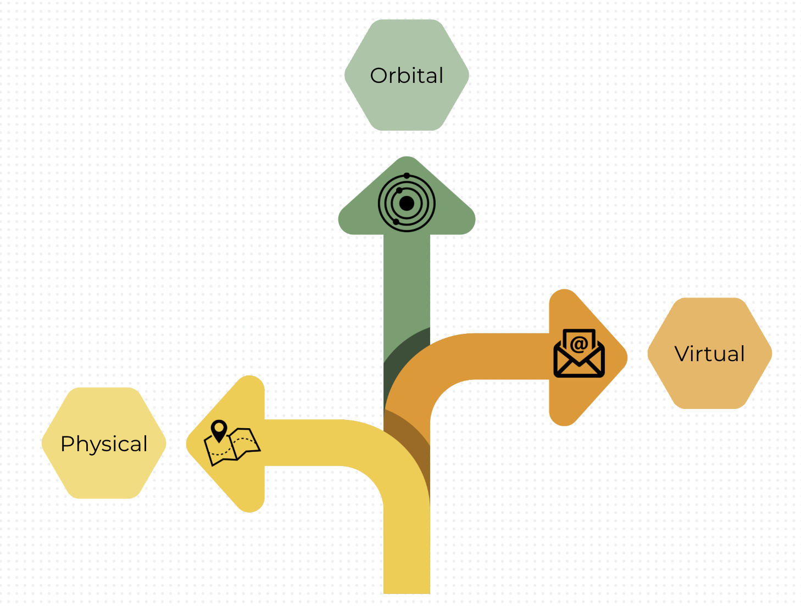
Notes:
LML Locations

Slide 38
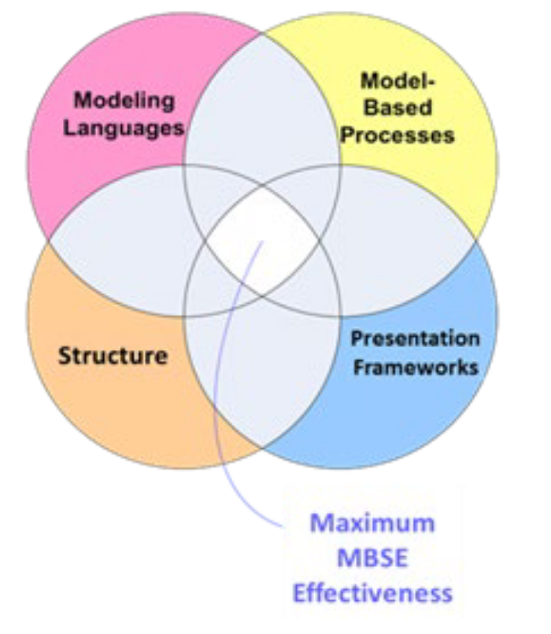
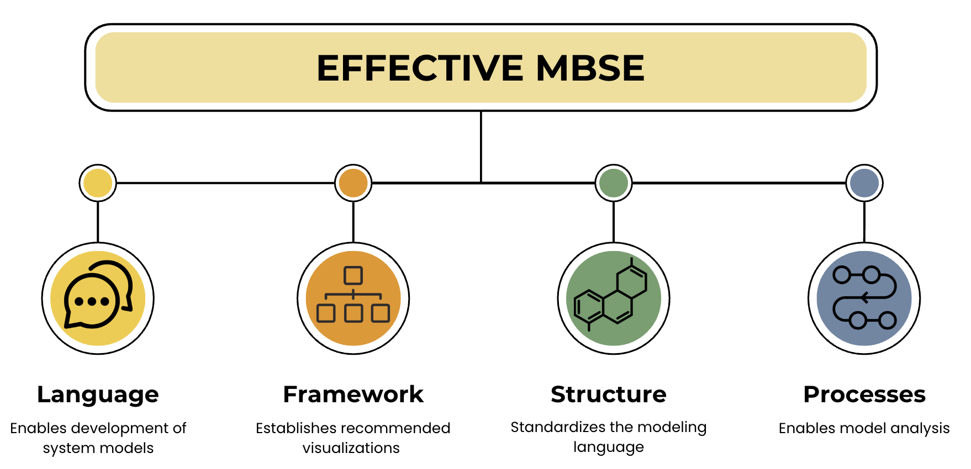
Notes:
Essential LML fig 4

Slide 39
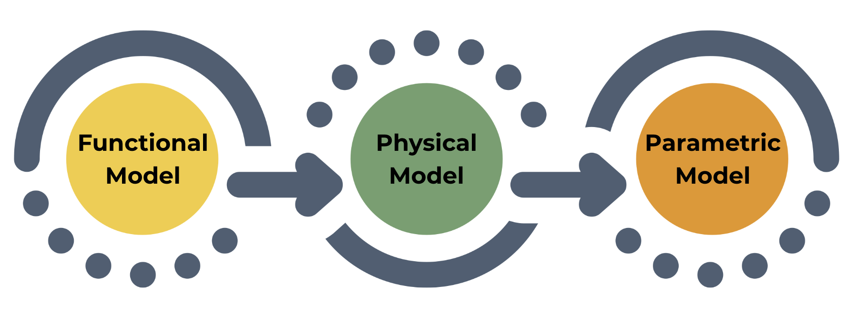

Slide 40
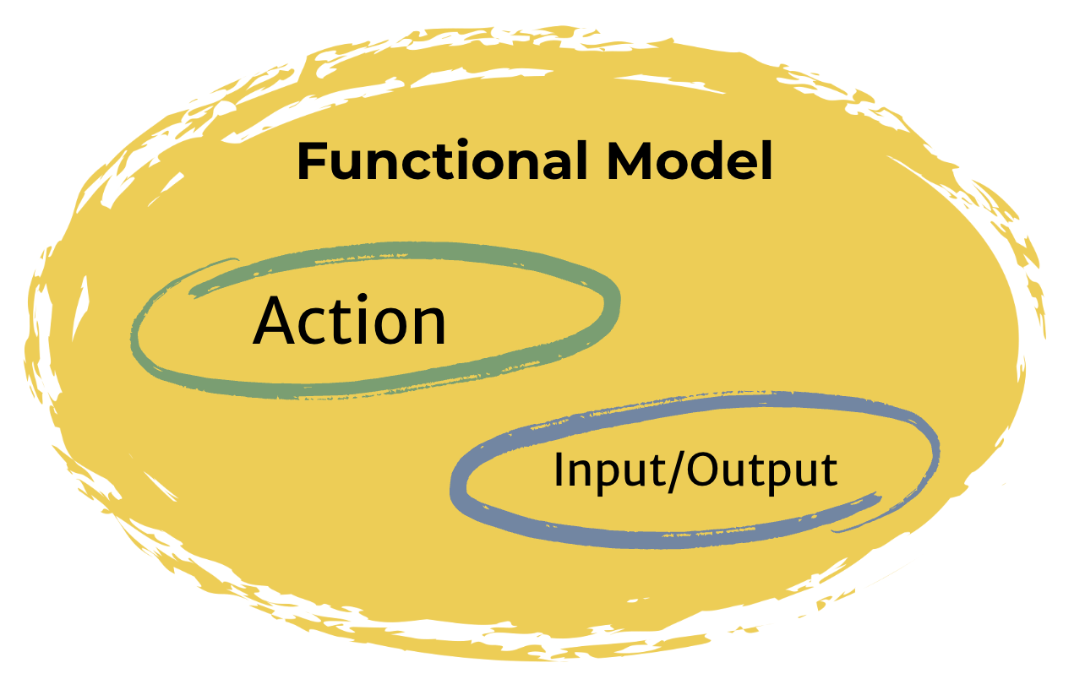

Slide 41
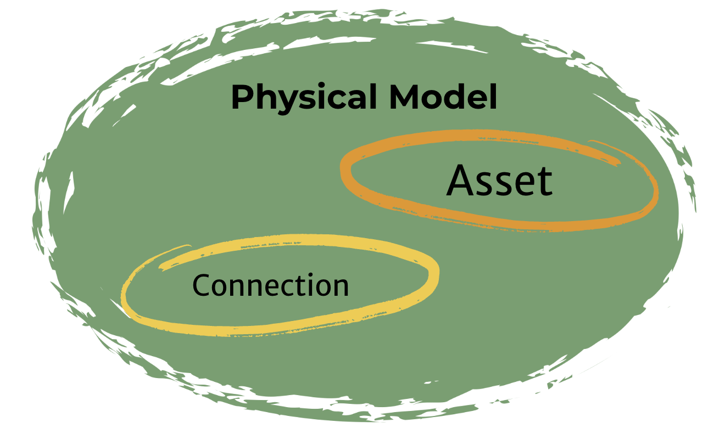

Slide 42
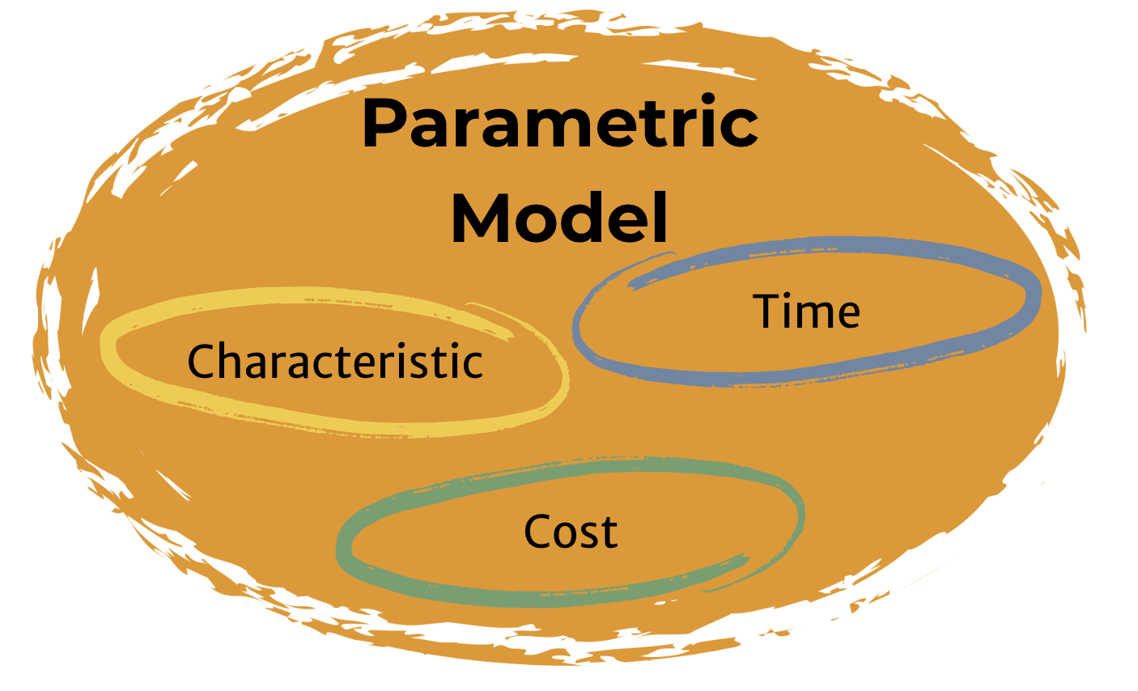

Slide 43
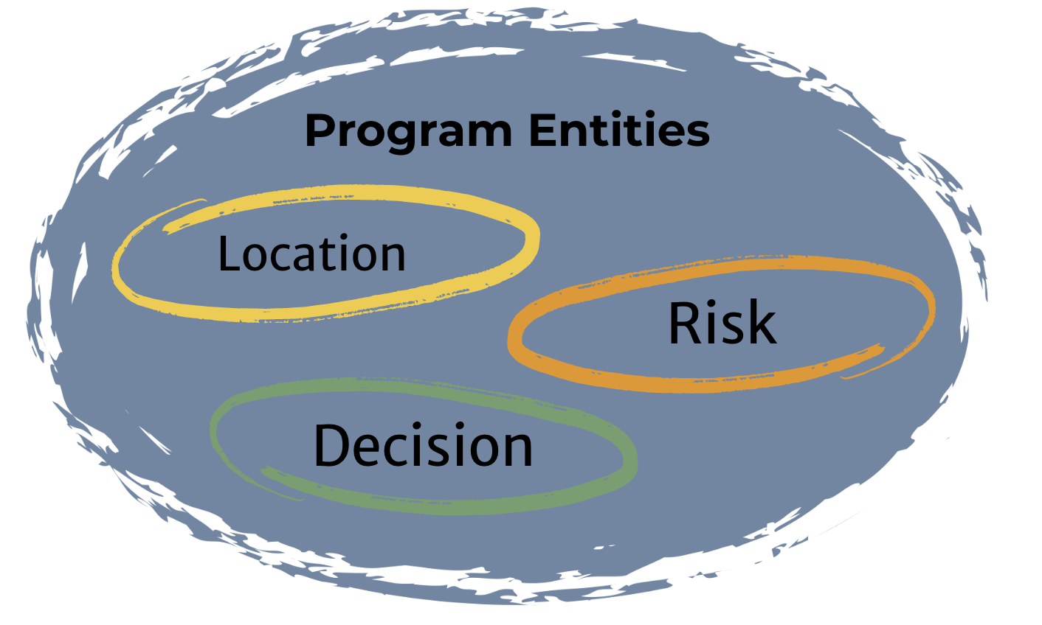

Slide 44
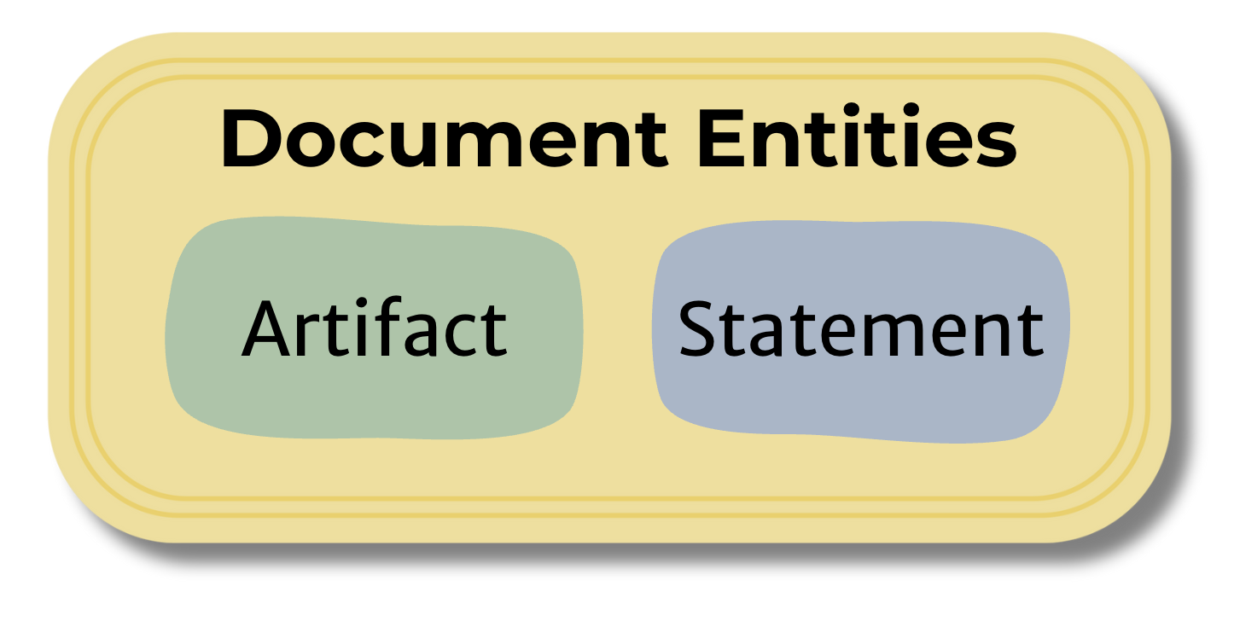

Slide 45
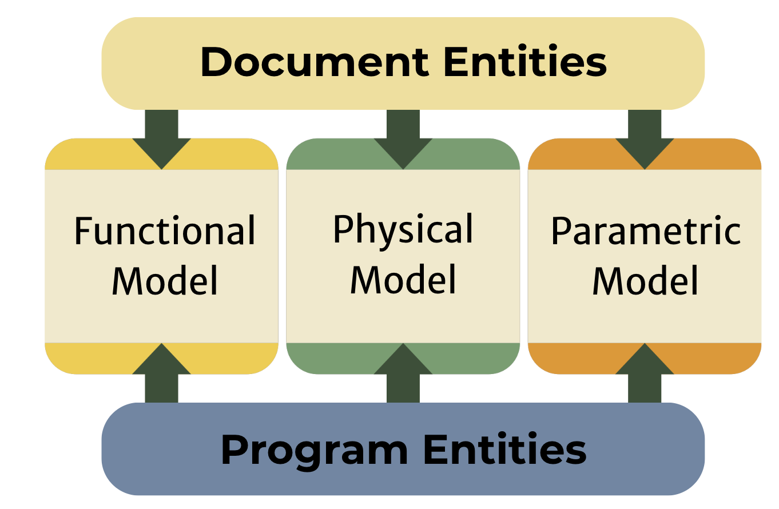
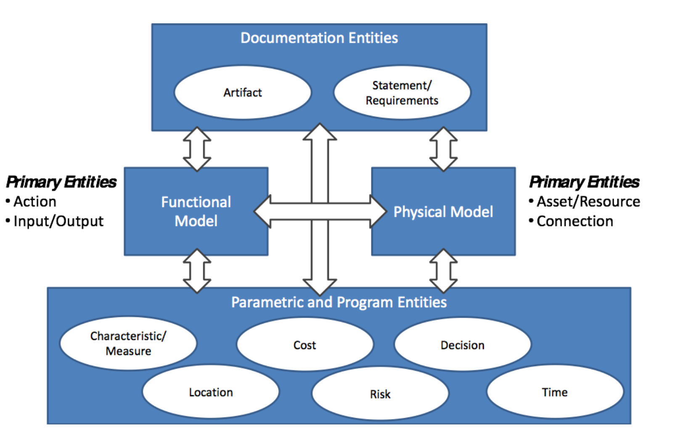

Slide 46


Slide 47


Slide 48


Slide 49


Notes:
Essential lml fig 14

Slide 50


Notes:
Essential LML fig 25

Slide 51


Notes:
Essential lml fig 20

Slide 52


Notes:
Essential LML fig 12

Slide 53

Notes:
Types of diagrams

Slide 54

Notes:
LML measures

Slide 55

Notes:
Table 3-1 LML spec

Slide 56


Notes:
Asset diagram LML fig 4-4

Slide 57

Notes:
LML gantt

Slide 58

Notes:
Requirement attributes LML spec

Slide 59

Notes:
LML mandatory diagrams

Slide 60

Notes:
state machine

Slide 61

Notes:
LML asset diagram model elements fig 4-6

